Slide 1
Pulse Compiler
03/22/2026
Timothy Keller

Slide 2
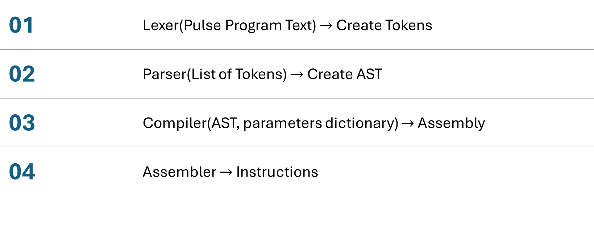
Compiler Steps
01 | Lexer(Pulse Program Text) $→$ Create Tokens
02 | Parser(List of Tokens) $→$ Create AST
03 | Compiler(AST, parameters dictionary) $→$ Assembly
04 | Assembler $→$ Instructions

Slide 3
Lexer

